Slide 1


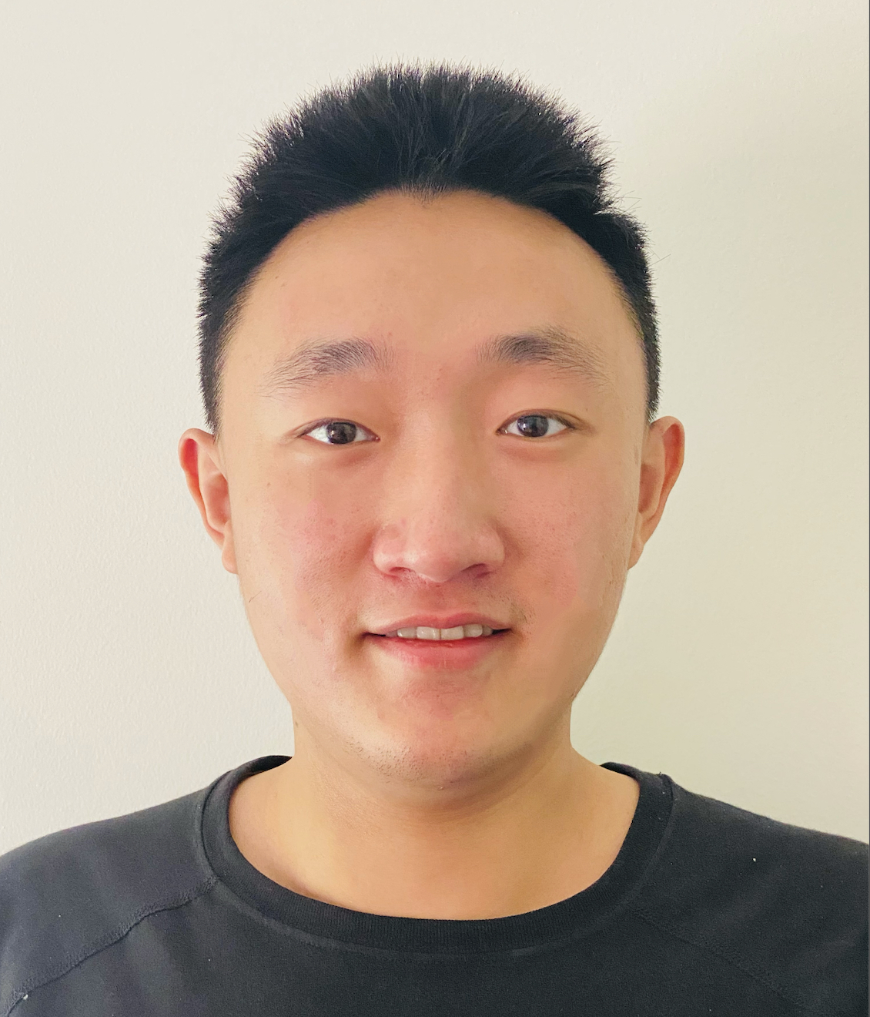
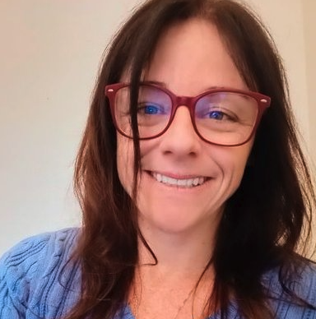

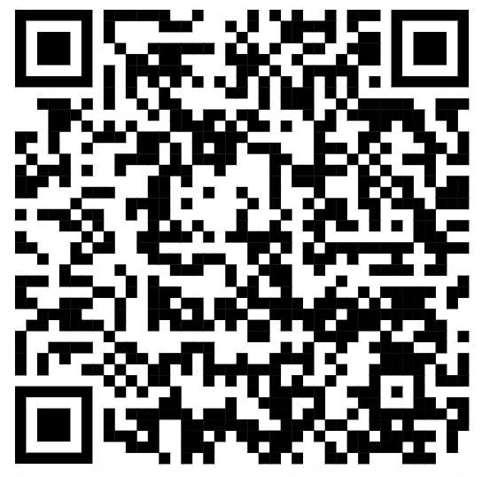

Empowering Engagement: Introducing a Dynamic Dashboard for Proactive Retention Strategies
Linux Plumbers 2023
Presented by: Zixuan Steve Feng, Dr. Bianca Trinkenreich, Dr.Anita Sarma
Empowering Engagement: Introducing a Dynamic Dashboard for Proactive Retention Strategies

Slide 2
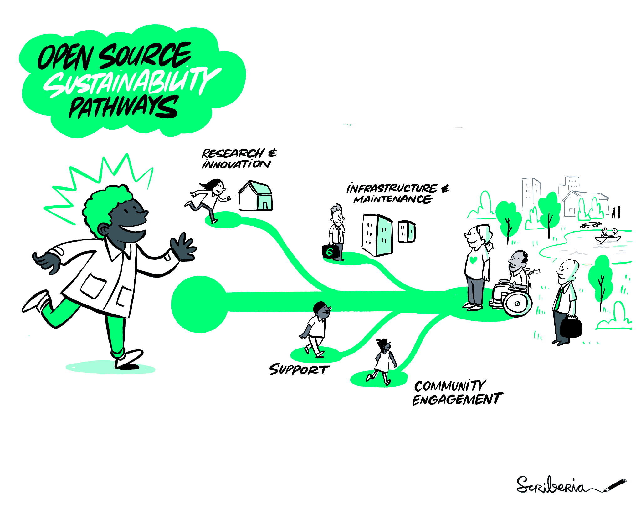
Retention in OSS communities
Retaining and keeping contributors engaged are crucial for ensuring the sustainability of OSS projects [1-2].
[1] Huilian Sophie Qiu, Alexander Nolte, Anita Brown, Alexander Serebrenik, and Bogdan Vasilescu. 2019. Going farther together: The impact of social capital on sustained participation in open source. In 2019 ieee/acm 41st international onference on software engineering (icse) IEEE, 688–699
[2] Minghui Zhou and Audris Mockus. 2012. What make long term contributors: Will- ingness and opportunity in OSS community. In 2012 34th International Conference on Software Engineering (ICSE). IEEE, 518–528.
Empowering Engagement: Introducing a Dynamic Dashboard for Proactive Retention Strategies

Slide 3
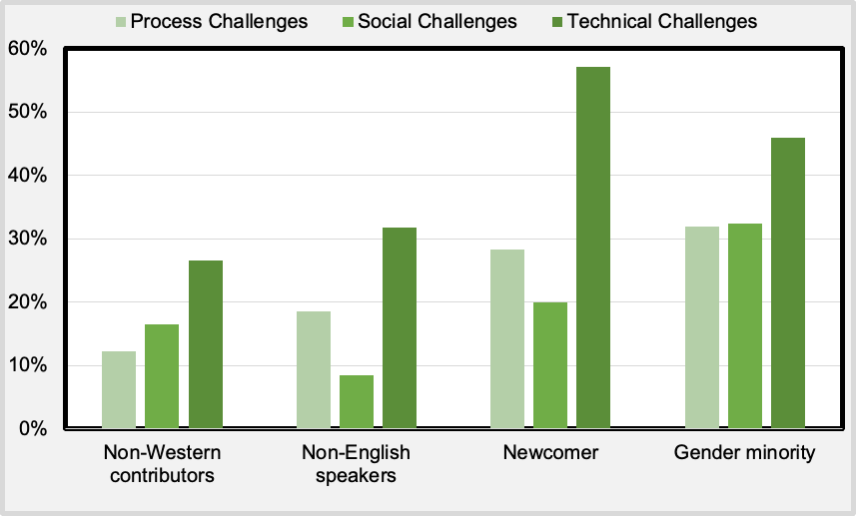
Retention in OSS communities
Contributors may leave due to different reasons, including their technical difficulties, social challenges, among others [1-5].
Fig.1 The three types of challenges that contributors face, disaggregated by demographics, were surveyed in 2022 within a large OSS foundation [5]
[1] Vasilescu, Bogdan, et al. "Gender and tenure diversity in GitHub teams." Proceedings of the 33rd annual ACM conference on human factors in computing systems. 2015.
[2] Zhang, Yuxia, et al. "Turnover of companies in OpenStack: Prevalence and rationale." ACM Transactions on Software Engineering and Methodology (TOSEM) 31.4 (2022): 1-24.
[3] Zhang, Yuxia, et al. "Corporate dominance in open source ecosystems: a case study of OpenStack." Proceedings of the 30th ACM Joint European Software Engineering Conference and Symposium on the Foundations of Software Engineering. 2022.
[4] Zhang, Yuxia, et al. "Companies’ participation in oss development–an empirical study of openstack." IEEE Transactions on Software Engineering 47.10 (2019): 2242-2259.
[5] Feng, Zixuan, et al. "The State of Diversity and Inclusion in Apache: A Pulse Check." arXiv preprint arXiv:2303.16344 (2023).
Empowering Engagement: Introducing a Dynamic Dashboard for Proactive Retention Strategies

Slide 4
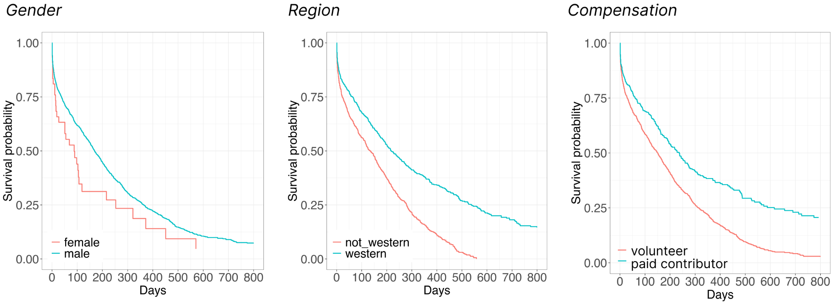
Contributors may leave, and this likelihood may vary according to different demographics [1-5].
Retention in OSS communities
Fig.2. The Kaplan-Meier survival curve estimates for contributors per diversity attributes from a large OSS community (Gender, Region, Compensation) [6]
[1] Vasilescu, Bogdan, et al. "Gender and tenure diversity in GitHub teams." Proceedings of the 33rd annual ACM conference on human factors in computing systems. 2015.
[2] Zhang, Yuxia, et al. "Turnover of companies in OpenStack: Prevalence and rationale." ACM Transactions on Software Engineering and Methodology (TOSEM) 31.4 (2022): 1-24.
[3] Zhang, Yuxia, et al. "Corporate dominance in open source ecosystems: a case study of OpenStack." Proceedings of the 30th ACM Joint European Software Engineering Conference and Symposium on the Foundations of Software Engineering. 2022.
[4] Zhang, Yuxia, et al. "Companies’ participation in oss development–an empirical study of openstack." IEEE Transactions on Software Engineering 47.10 (2019): 2242-2259.
[5] Feng, Zixuan, et al. "The State of Diversity and Inclusion in Apache: A Pulse Check." arXiv preprint arXiv:2303.16344 (2023).
[6] Feng, Zixuan. "The State of Survival in OSS: The Impact of Diversity." (2023)
Empowering Engagement: Introducing a Dynamic Dashboard for Proactive Retention Strategies

Slide 5
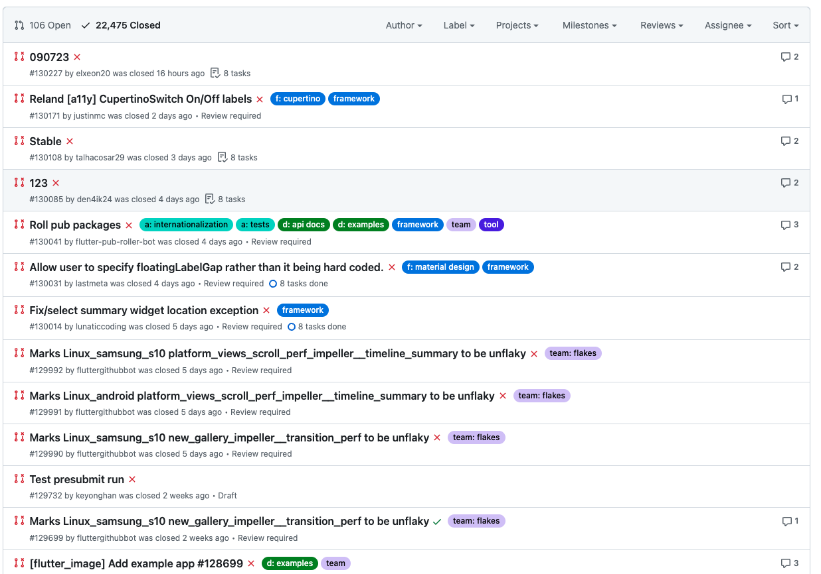
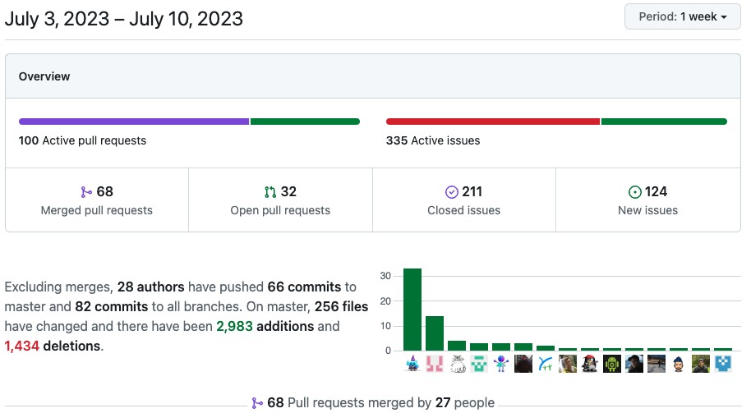
Maintainers in OSS communities
Project maintainers are often overwhelmed handling regular management tasks.
Empowering engagement with existing tools is challenging
Empowering Engagement: Introducing a Dynamic Dashboard for Proactive Retention Strategies

Slide 6
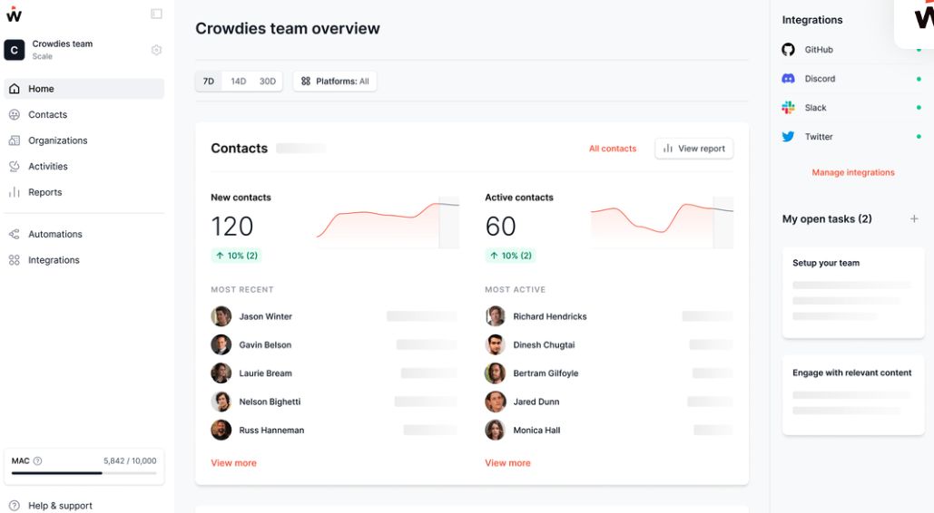
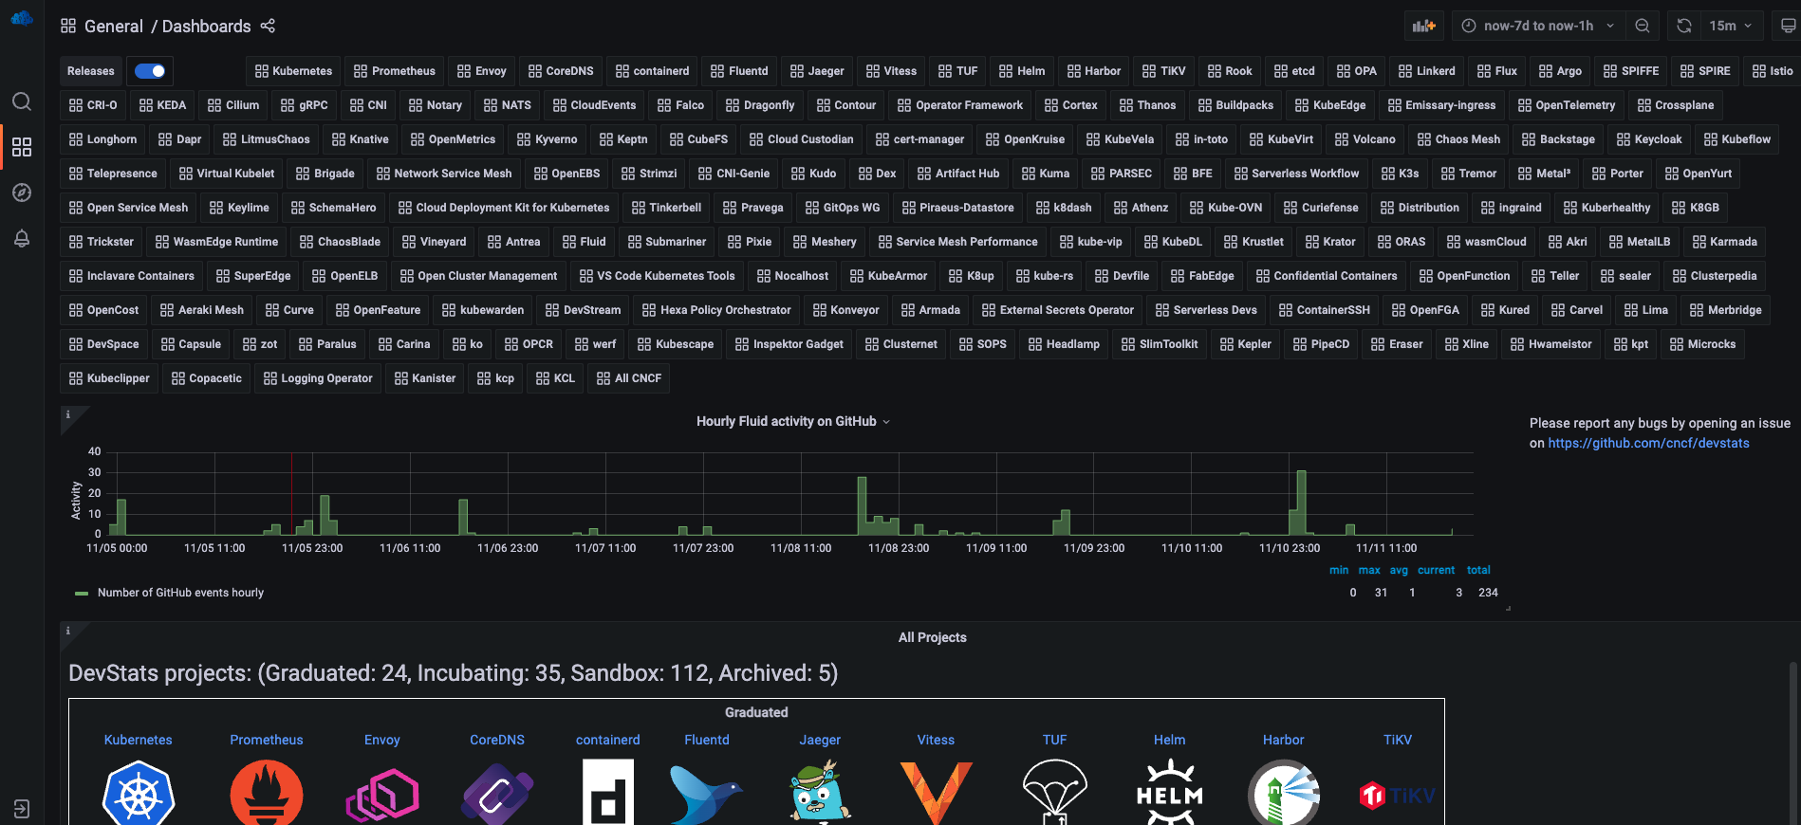
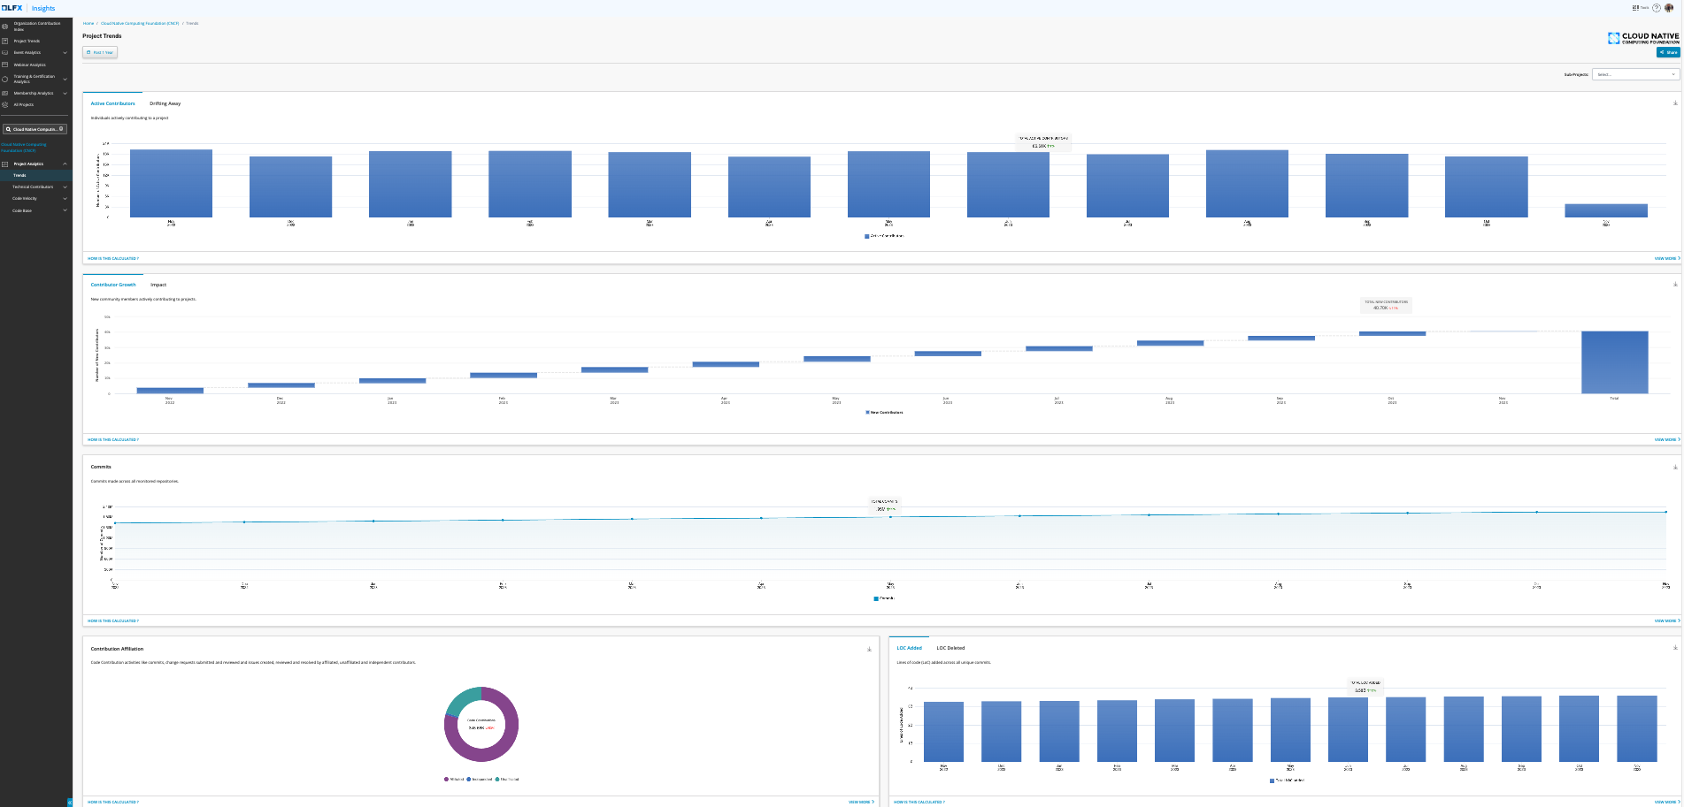
Maintainers in OSS communities
Existing tools are available for project maintainers to monitor project engagement.
Crowdev
CNCF devstats
Linux insight
Empowering Engagement: Introducing a Dynamic Dashboard for Proactive Retention Strategies

Slide 7
Empowering Engagement: Survival Dashboard
Retention focused
Quick understanding of project state and drill down for actionable strategies
Empowering Engagement: Introducing a Dynamic Dashboard for Proactive Retention Strategies

Slide 8

Survival dashboard
A dynamic, interactive dashboard for insights into contributor retention across diversity lens, serving as a strategic tool for project maintainers.
Empowering Engagement: Introducing a Dynamic Dashboard for Proactive Retention Strategies

Slide 9
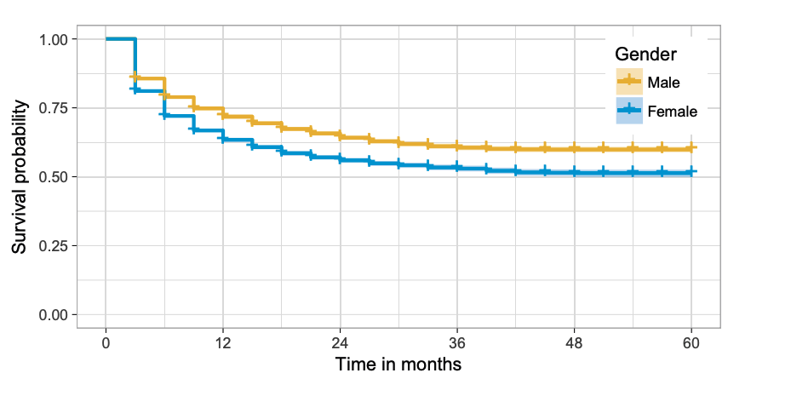
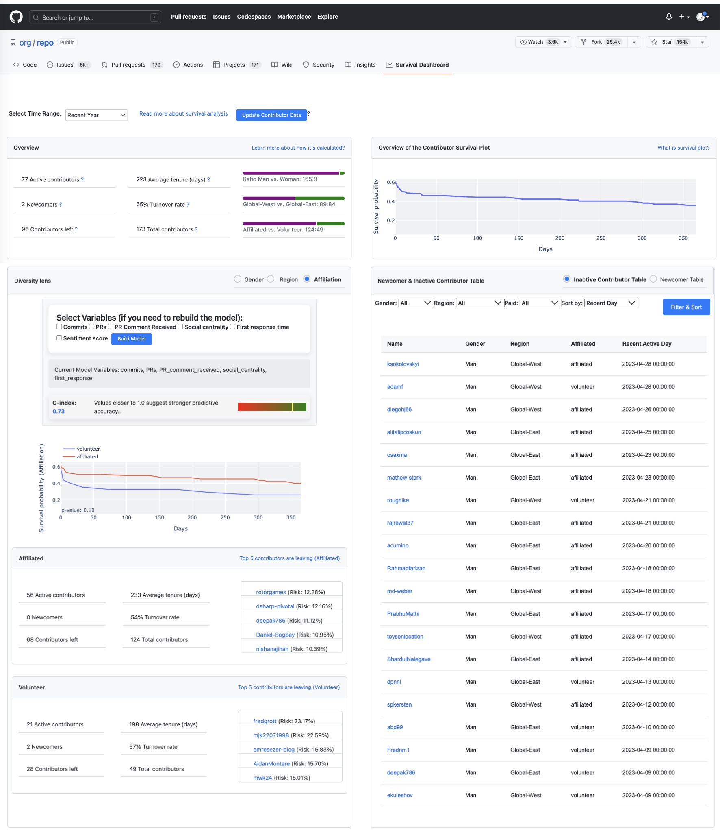

Survival dashboard
Survival probability of men contributors
Survival probability of women contributors
1. Interview & academic literature review
Priority information regarding survivability
Fig.3. Kaplan-Meier estimators: women disengage significantly earlier (Qiu et al., 2019)
2. Prototype designing
Following dashboard design principles (Few,2006)
3. Evaluation
User study across multiple OSS projects
Feedback wanted
Empowering Engagement: Introducing a Dynamic Dashboard for Proactive Retention Strategies

Slide 10

Survival dashboard
Time selectors
GitHub designs.
Project overview
Newcomer & Inactive contributors
Demographic comparison
Individual level
Empowering Engagement: Introducing a Dynamic Dashboard for Proactive Retention Strategies

Slide 11
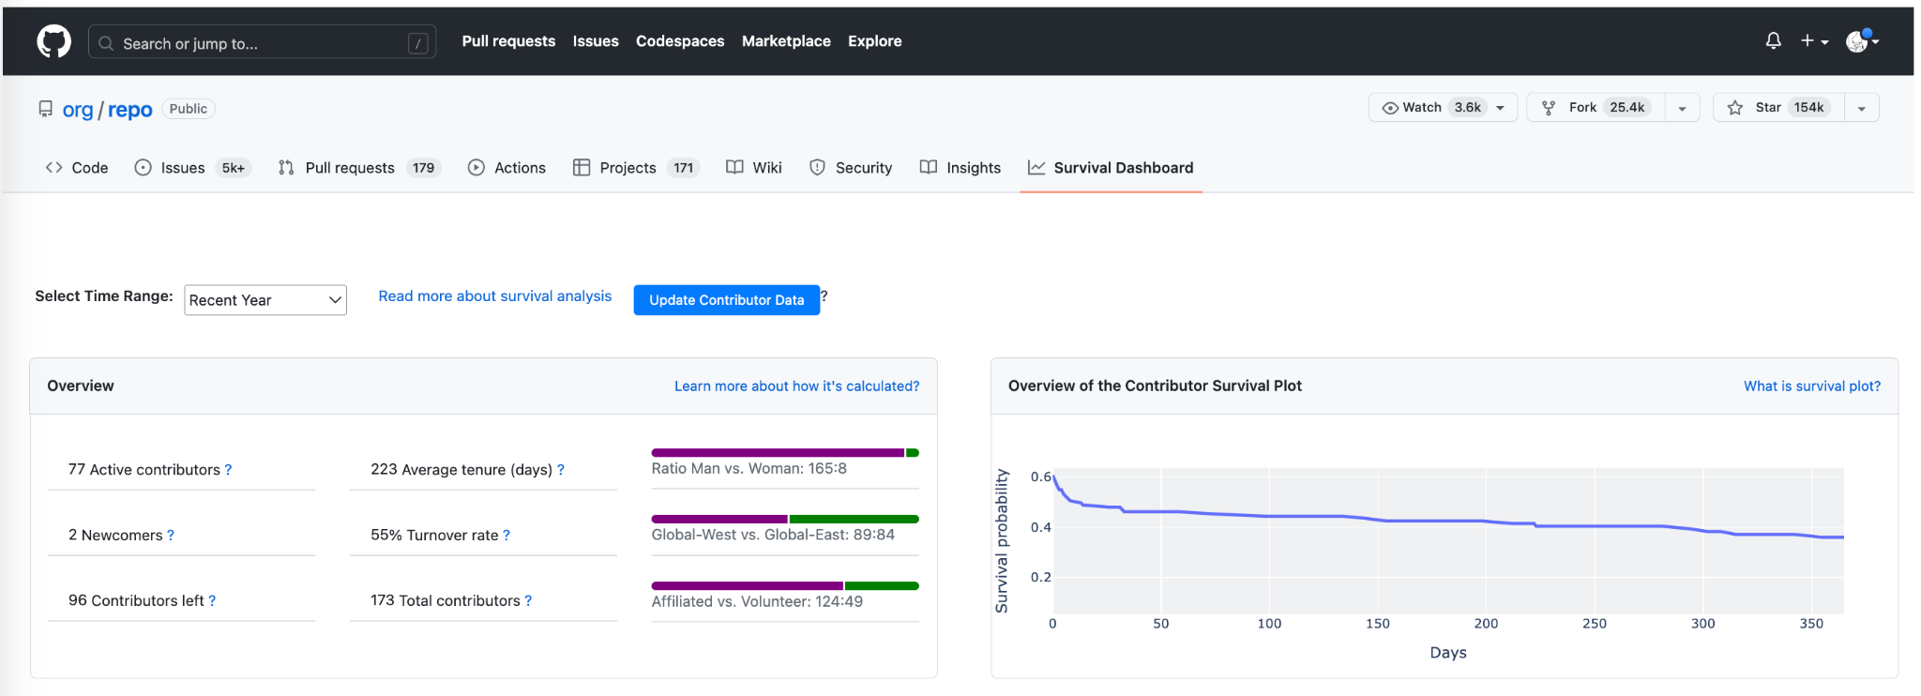

Survival dashboard
PMC Chair---Riley
Empowering Engagement: Introducing a Dynamic Dashboard for Proactive Retention Strategies

Slide 12
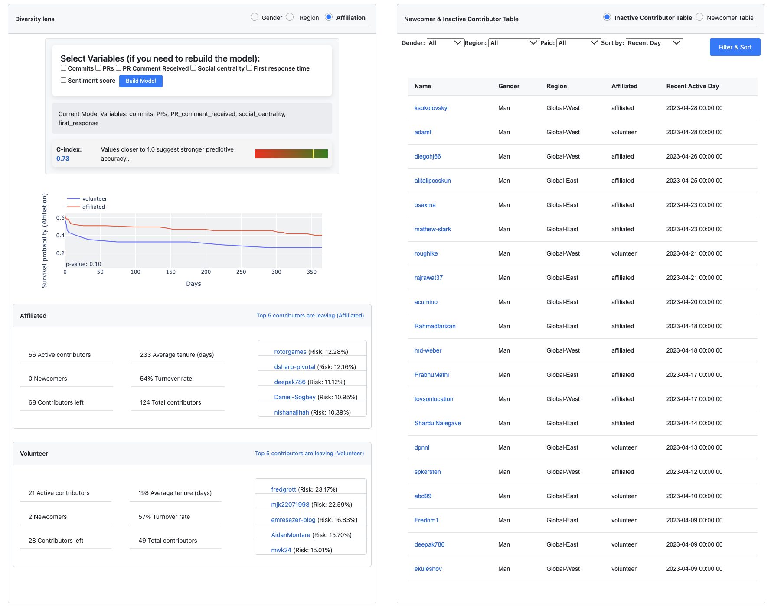
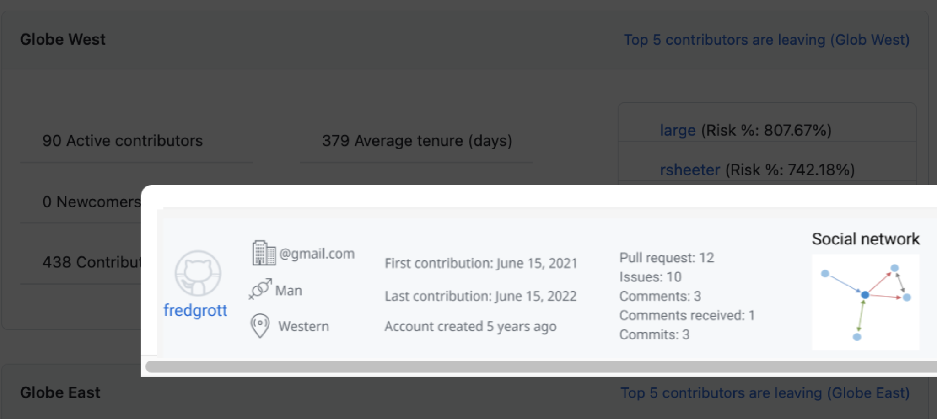
Survival dashboard
PMC Chair---Riley
Empowering Engagement: Introducing a Dynamic Dashboard for Proactive Retention Strategies

Slide 13

Survival dashboard
For the OSS Community: fostering collaboration, ensuring its long-term success. It helps stakeholders in making data-driven decisions.
For OSS Projects: benefit from the dashboard as it assists in monitoring the state of collaborations, a crucial aspect of sustaining their success.
For OSS Maintainers: helps maintainers monitor contributors’ retention, saving their time and simplifying their tasks.
Empowering Engagement: Introducing a Dynamic Dashboard for Proactive Retention Strategies

Slide 14
Open Discussion and Q&A
What challenges do you face in retaining contributors?
What challenges do you face when monitoring contributors’ retention?
Feedbacks on dashboard
How would you use this tool ?
What do you think we are missing ?
Empowering Engagement: Introducing a Dynamic Dashboard for Proactive Retention Strategies

Slide 15

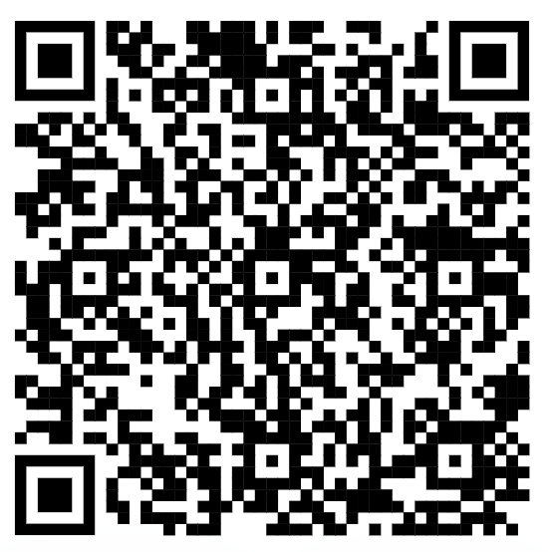



Thank you !
for your time and participation.
Presented by: Zixuan Steve Feng, Dr. Bianca Trinkenreich, Dr.Anita Sarma
Contact
Sponsors:
Empowering Engagement: Introducing a Dynamic Dashboard for Proactive Retention Strategies

